Slide 1
Todo sobre PnP JS y PnP React components
Luis Mañez

Slide 2

Luis Mañez
Chief Architect
ClearPeople LTD (UK)
github.com/luismanez
twitter.com/luismanez
www.linkedin.com/in/luismanez
Office Development MVP. About 20 years of experience working with Microsoft Technologies. MS Certified specialist in Developing Azure and SharePoint MCPD. Passionate about technology, blogger, technical writer and MS community active member.

Slide 5
Patterns and practices
A.K.A PnP

Slide 6
The SharePoint Development Community (also known as the SharePoint PnP community) is an open-source initiative coordinated by SharePoint engineering.
This community controls SharePoint development documentation, samples, reusable controls, and other relevant open-source initiatives related to SharePoint development.
https://docs.microsoft.com/en-us/sharepoint/dev/community/community

Slide 7
Pnp javascript
A.K.A PnP JS

Slide 8
PnPjs is a collection of fluent libraries for consuming SharePoint, Graph, and Microsoft 365 REST APIs in a type-safe way.
You can use it within SharePoint Framework, Nodejs, or any JavaScript project.

Slide 9
PnPJS Available Packages
adaljsclient
Provides an adaljs wrapper suitable for use with PnPjs
common
Provides shared functionality across all pnp libraries
config-store
Provides a way to manage configuration within your application
graph
Provides a fluent api for working with Microsoft Graph
logging
Light-weight, subscribable logging framework
msaljsclient
Provides an msal wrapper suitable for use with PnPjs
nodejs
Provides functionality enabling the @pnp libraries within nodejs
odata
Provides shared odata functionality and base classes
sp
Provides a fluent api for working with SharePoint REST
sp-addinhelpers
Provides functionality for working within SharePoint add-ins

Slide 10

Let´s jump into it!!

Slide 11
Pnp React controls

Slide 12
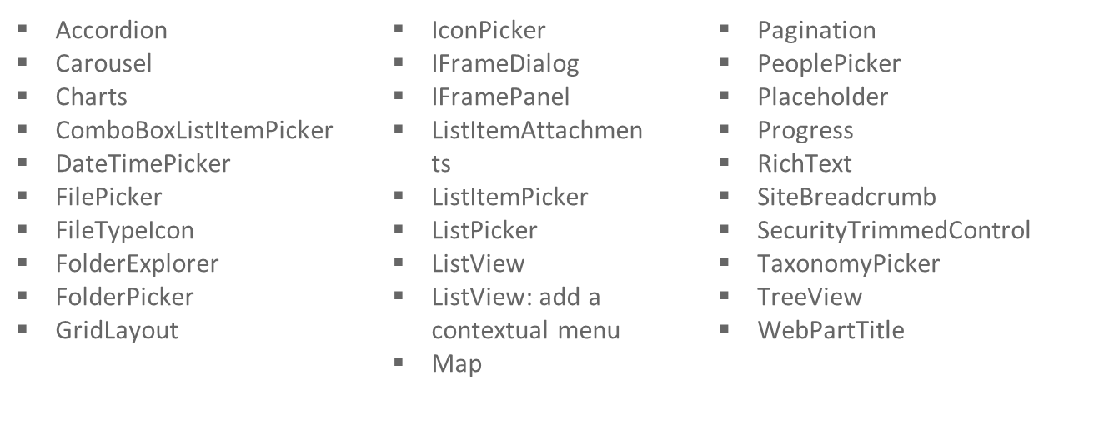
Webpart controls
https://pnp.github.io/sp-dev-fx-controls-react/controls/Accordion/

Slide 13
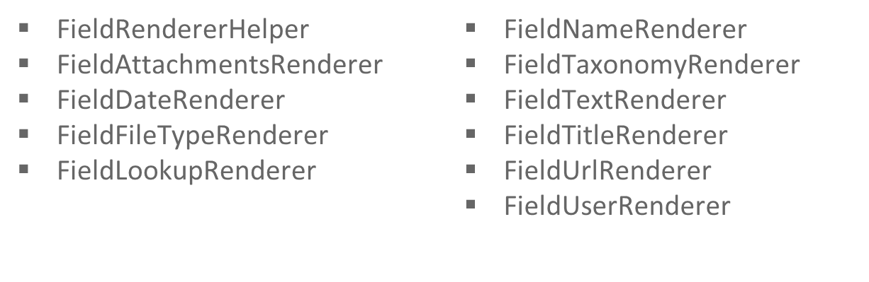
Field controls
https://pnp.github.io/sp-dev-fx-controls-react/controls/fields/main/

Slide 14
Pnp React property controls

Slide 15
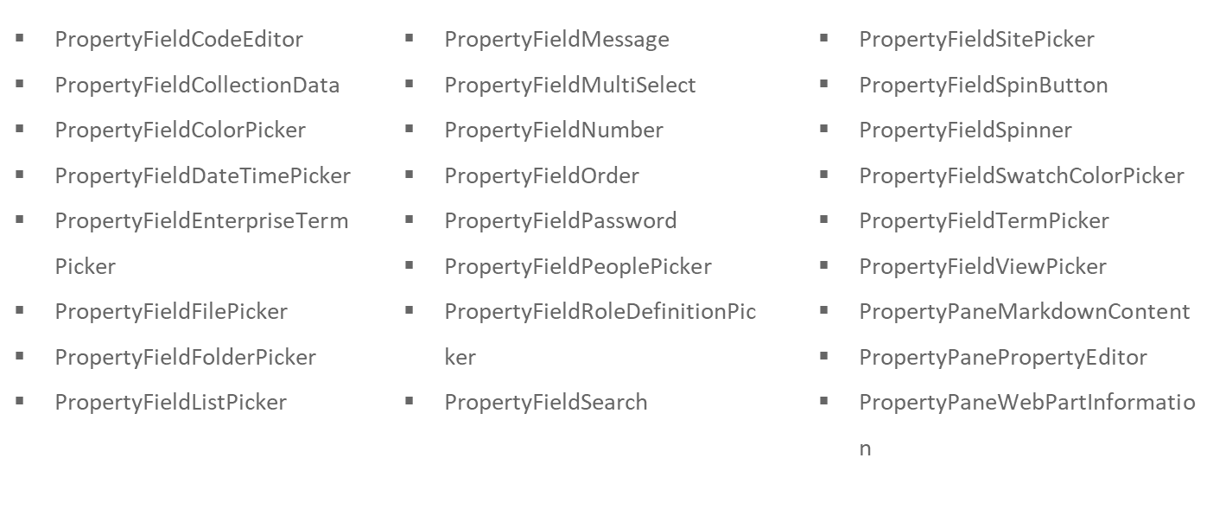
Property controls
https://pnp.github.io/sp-dev-fx-property-controls/controls/PropertyFieldCodeEditor/

Slide 16
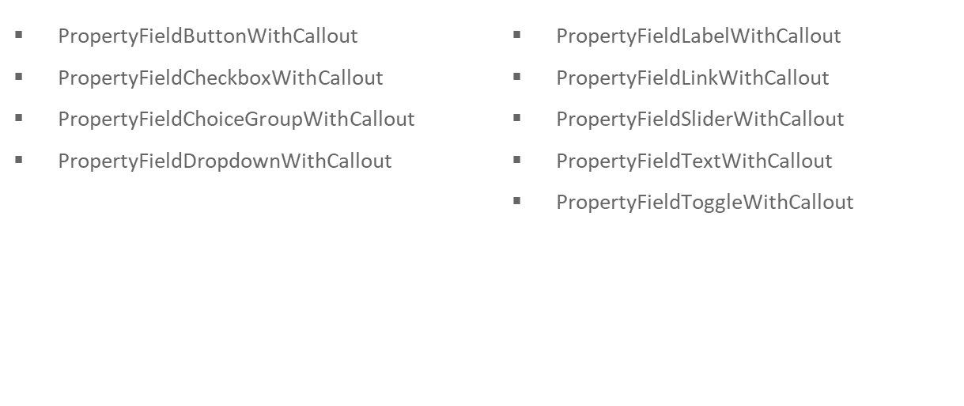
Property controls with callout
https://pnp.github.io/sp-dev-fx-property-controls/controls/PropertyFieldButtonWithCallout/

Slide 17

https://github.com/luismanez/m365-saturday-madrid-virtual

Slide 19
Thanks!

